Slide 1
NBA shot predictions
Ankit Patel
GADS 22 Project -- 19-Aug-2015

Slide 2
Overview / Hypotheses
Can NBA statistics/data be used to predict in game events?
Shooting tendencies (sweet spots?)
FG% based on shot location, defender proximity, shot clock, defender effectiveness
How should an opposing coach best deploy their defensive unit
Can a Linear or Logistic model be used to predict outcome with high degree of success?
Hypotheses (based on personal knowledge of the sport)
Closer shots should have >FG%
Closer defender proximities should have <FG%
Lesser time on the shot clock should have <FG%

Slide 3
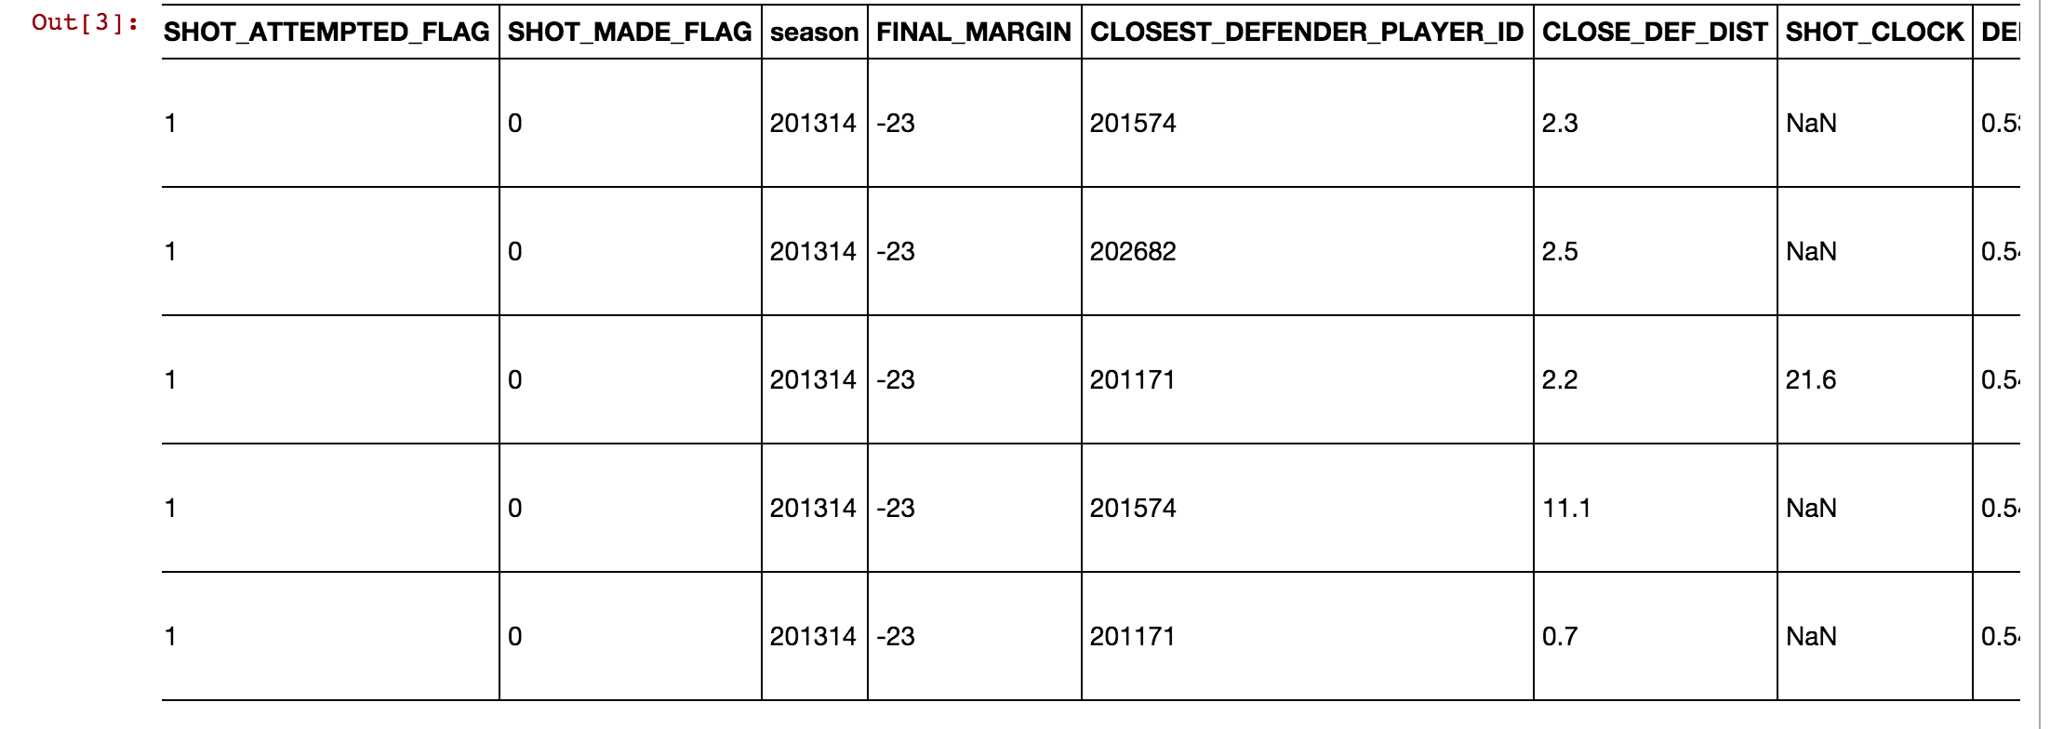
Data description
Data source: NBA Stats API (http://stats.nba.com/stats/)
Data to be used:
Past three seasons
Shot Location (categorized into 15 regions)
Shot Clock time remaining
Defender proximity
Defender success (calculated new parameter of missed shots against this defender)

Slide 4
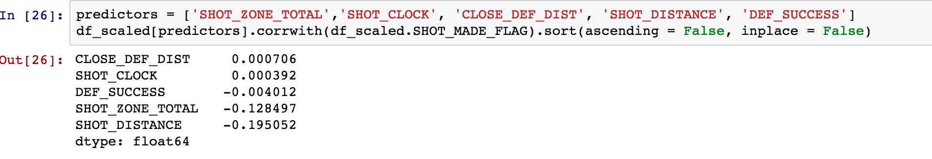
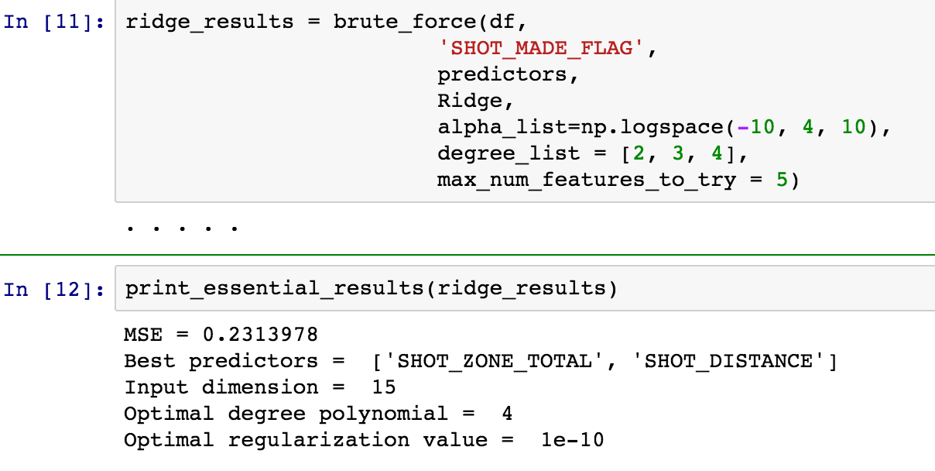
Linear regression

Slide 5
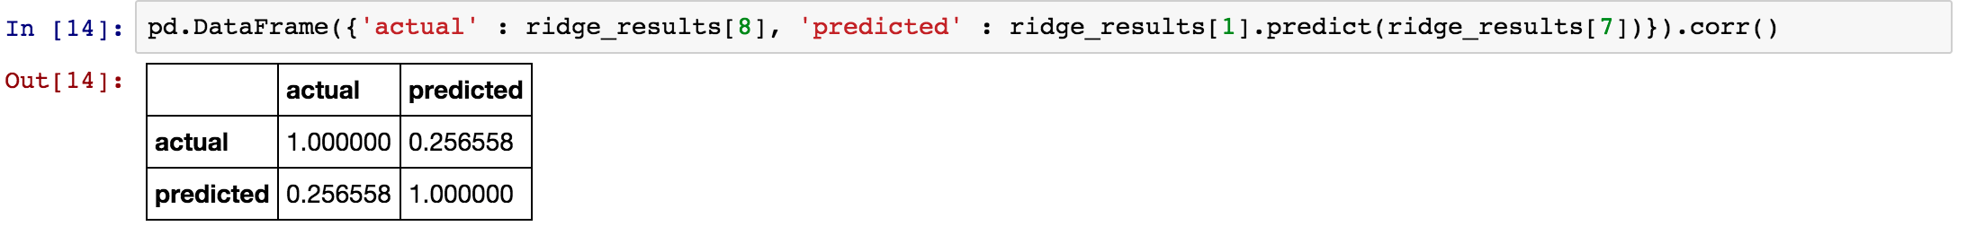
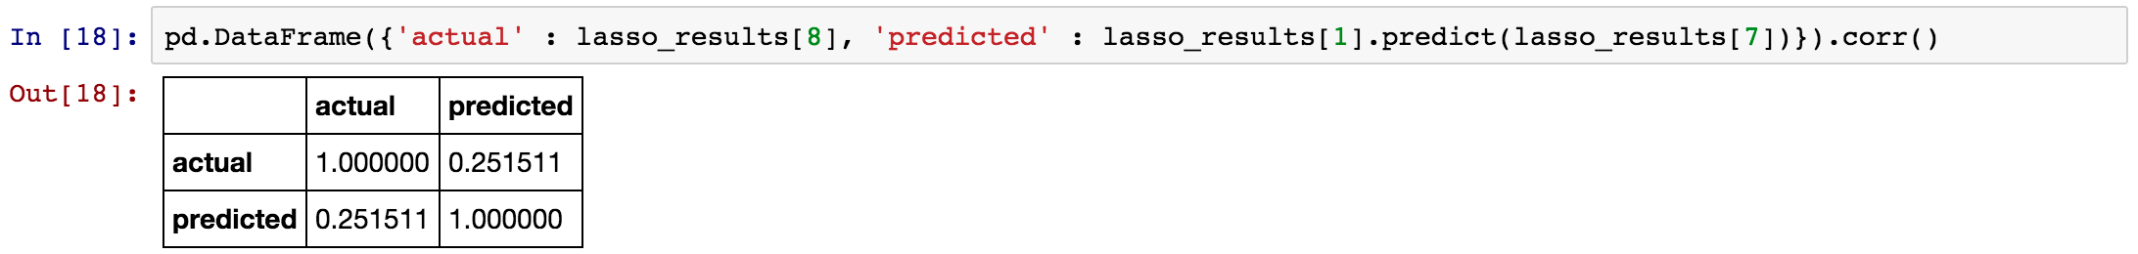
Linear regression, cont’d
Low level of accuracy given the Ridge model
Slightly worse results using Lasso model

Slide 6
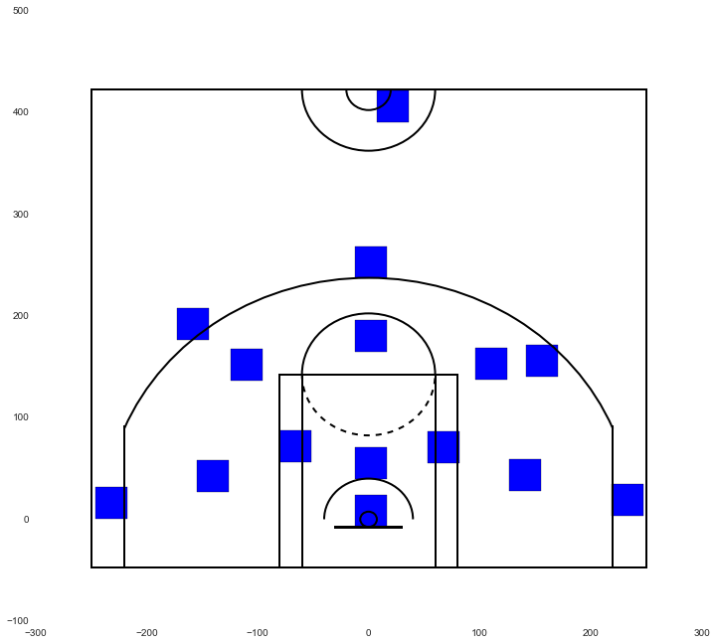
Observe shooting tendencies
Regions:

Slide 7
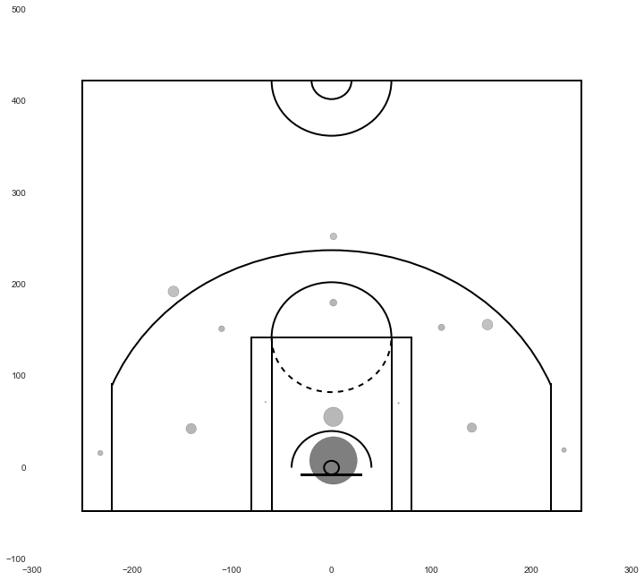
FG% Weighted Heat Map, NBA
~35% FG
~60% FG

Slide 8
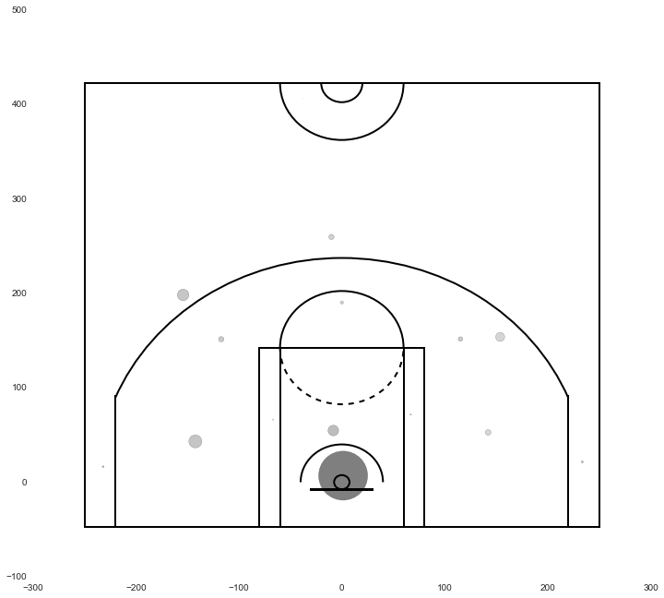
FG% Weighted Heat Map, LBJ
~33% FG
~75% FG

Slide 9
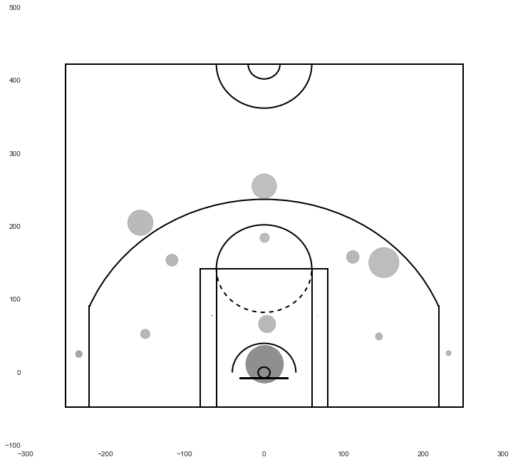
FG% Weighted Heat Map, S. Curry
~45% FG
~50% FG
~72% FG

Slide 10
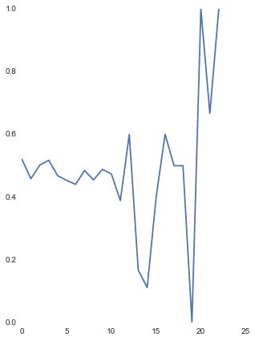
FG% conditional on Def Proximity
Defender proximity didn’t seem to affect Steph Curry
FG%
Defender’s distance in feet

Slide 11
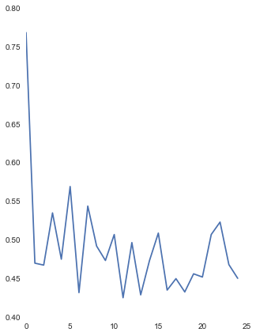
FG% conditional on Shot Clock
Less time seems to be beneficial to Steph Curry’s FG%. (May coincide with his position, setting up a play as time counts down?)
FG%
Seconds

Slide 12
Take aways/Difficulties
Take aways:
Linear regression didn’t fair so well, so switched to just observational tendencies
A couple of hypotheses were correct: Closer shots tend to have higher FG%
Closer shots also seem most efficient (risk/reward), and therefore the more commonly taken shot
Difficulties:
How each of the parameters in this experiment are affected by other (sometimes untracked) parameters in a dynamic way. (ie. shot with a defender more or less difficult if your teammates are nearby?)

